Slide 1

EXTENSION & REVITALIZATION
PROGRAM
Karlene Beams
2025-2026
National Chief of Staff & Ambassador

Slide 2

EXTENTION – STARTING A NEW AUXILIARY
REVITALIZATION – NEW LIFE AND VITALITY
MENTORING – TO ADVISE AND/OR TRAIN

Slide 3

EXTENSION STEPS
Identify Unaffiliated Posts.
Contact Department President or Chief of Staff to discuss possibility of a new Auxiliary.
Review MALTA for presentation tools.
Ask the Post Commander for permission to make a presentation.
Invite the President and/or Chief of Staff to attend meeting with the Post.
Gain a 2/3 approval vote from Post membership.
Department President will appoint an organizer to work with the Post.
Mentor the new Auxiliary and members until healthy!

Slide 4
REVITALIZATION
HEALTHY AUXILIARIES
Have met the 5 Essentials
Minimum of (10) business meetings per year (Sec. 210 A).
Dues paid for (10) members by February 1 (Sec. 207 C). See also Chief of Staff duties (Sec. 815 A).
Up-to-date quarterly audits by Trustees (Sec. 814).
Officers elected, installed and reported to National Headquarters (Sec. 804, 806).
The offices of President and Treasurer MUST be bonded (Sec. 806 A).

Slide 5

Struggling Auxiliaries
The District President or Official Representative visit can identify the following:
5 Essentials of a Healthy Auxiliary that may not have been met
    Not attracting new members
    Program reports not completed
    Veterans and families not receiving assistance
    Officers remain the same year after year
    Internal personality issues

Slide 6
STRUGGLING AUXILIARY PLAN
PERFORMANCE IMPROVEMENT PLAN
“P I P”

Slide 7

P I P
Department President assigns a PIP team to take the lead.
PIP Team meets with Auxiliary Officers or individuals to identify issues and possible resolution, OR:
PIP Team meets with Auxiliary Officers or individuals and together set goals and develop a plan to achieve goals. Then:
Plan is implemented using NEW PIP form.
Mentoring of Officers and members is a critical part of a “PIP.”
PIP Team attends Auxiliary meetings until issues or goals have been met.
Expected Result
Auxiliary Restored to Healthy

Slide 8

SUSPENSION
RED FLAG AUXILIARY
Simply means it’s time to assign a team to work very closely with the Officers and members to bring them back to being a healthy Auxiliary.
The Department President requests the Auxiliary be put on Suspension.
A team is assigned to attend meetings and report findings to the Department President.
Usually, a minimum of 90 days with monthly team reports.
Mentoring is a huge part of the suspension process.
Remove from suspension and continue mentoring.

Slide 9
MENTORING
  Prepares members to become educated leaders
  Ensures legacy of the VFW Auxiliary
  Creates strong and healthy Auxiliaries
  Auxiliaries more forward not “anchored in the past”
  Encourages and offers guidance
  Guarantees the Auxiliary future

Slide 10

CHIEF OF STAFF
Primary assistant to the Department President
Aids in institution and training of new Auxiliaries
Eyes and ears on all Department proceedings
Knowledgeable in all facets of Auxiliary to include:
Bylaws, Programs and Mentoring skills
Identifies warning signs of struggling Auxiliaries
Promotes use of MALTA to teach and inform members
KIND – SUPPORTIVE - PATIENT

Slide 11

EXTENSION - REVITALIZATION AWARDS
Award for Members
$25 VFW Store gift certificate to one member in each of the 10 Program Divisions for the best assistance to the Chief of Staff in establishing a new Auxiliary with the approval of the Department President.
“NEW” Award for District President
$25 VFW Store gift certificate to one District President or Official Representative in each of the 10 Program Divisions for the best assistance to the Chief of Staff with a struggling VFW Auxiliary by mentoring and maintain a close relationship until the Auxiliary becomes Healthy, with the knowledge of the Department President. Use of MALTA Member Resources Healthy Auxiliary tools and mentor training is required.
Awards for Department & Department Chairman
$25 VFW Store gift certificate to one or Department Chief of Staff in each of the 10 Program Divisions for the most unique promotion educating members to maintain healthy Auxiliaries and to promote Extension while utilizing MALTA Member Resources.

Slide 12
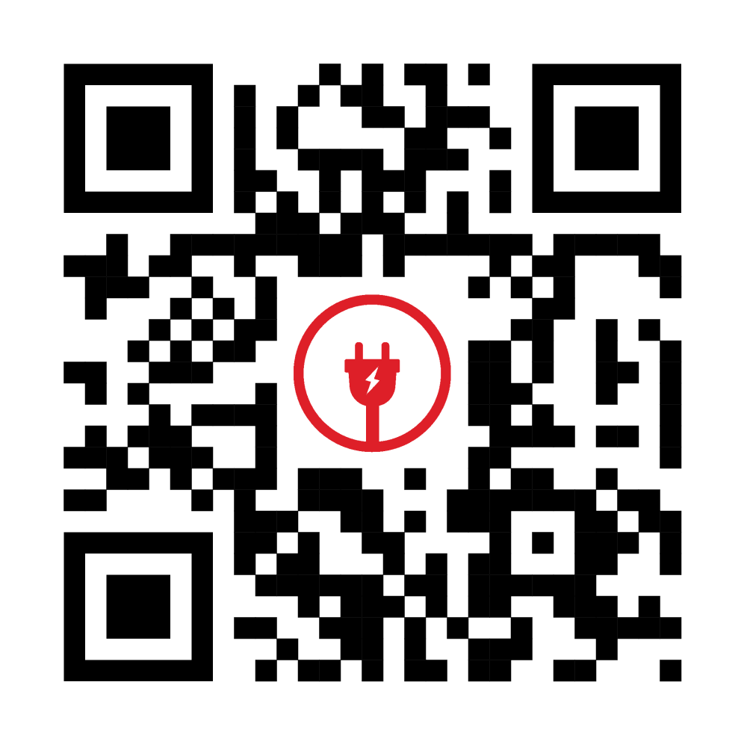


Add Contact Info
Scan this QR code and it will take you to the Extension & Revitalization Program information on the Auxiliary website.
Fillable Program Business Cards will be located in MALTA Member Resources beginning 2025-2026 year to add your contact information to.

Slide 13

YOU CAN’T STOP
THE WAVES,
BUT,
YOU CAN
LEARN
TO SURF!!!

